Slide 1
Signal processing

Slide 2
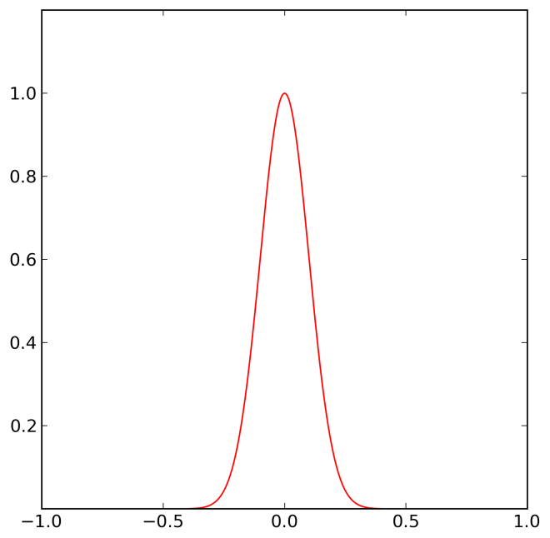
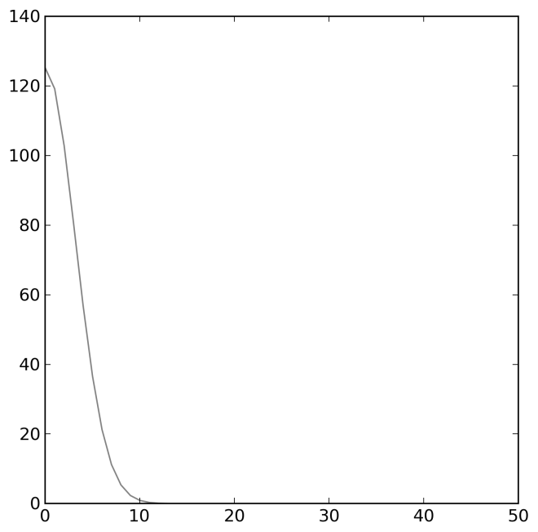
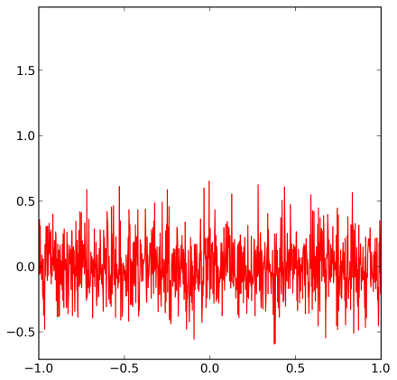
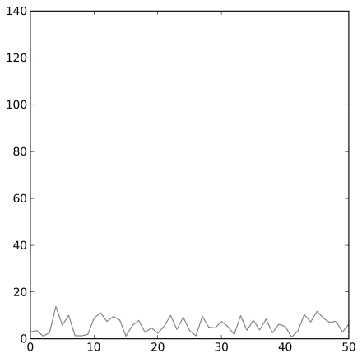
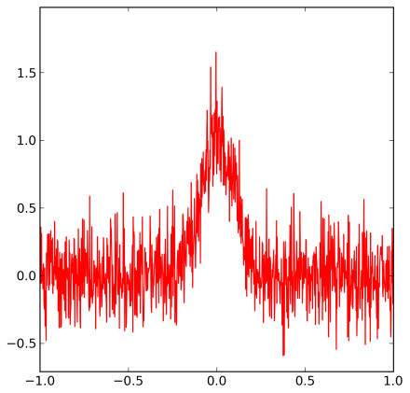
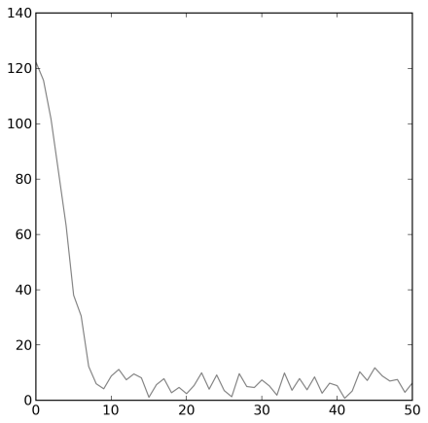
Gaussian peak with normal noise
Frequency
Frequency
Frequency

Slide 3
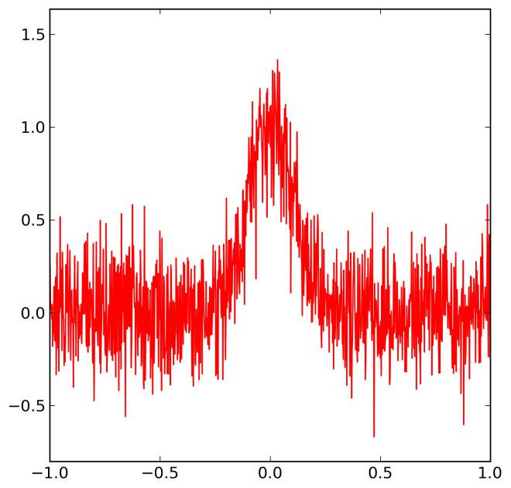
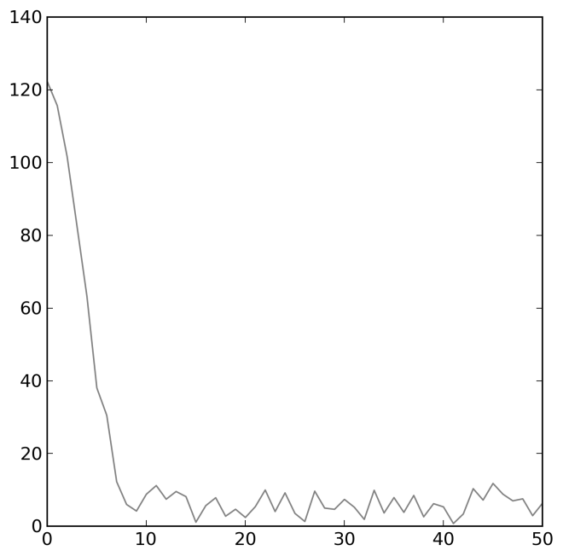
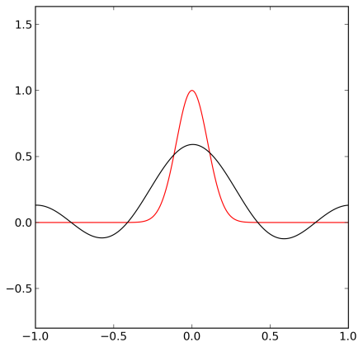
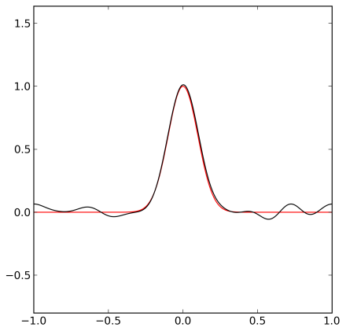
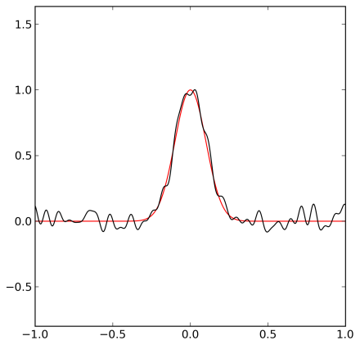
Removing High Frequences
Frequency

Slide 4
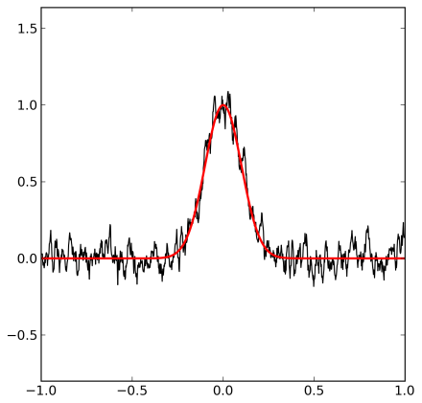
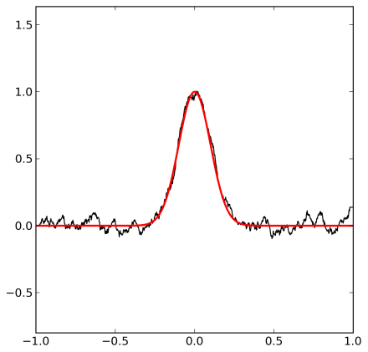
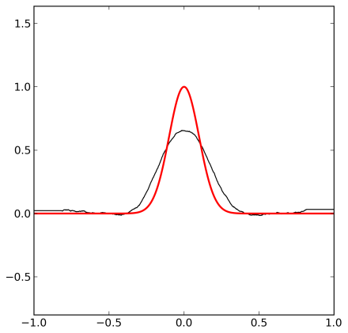
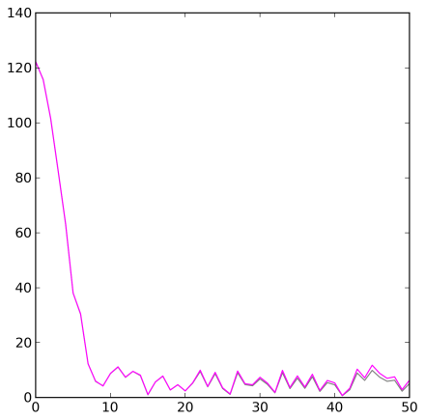
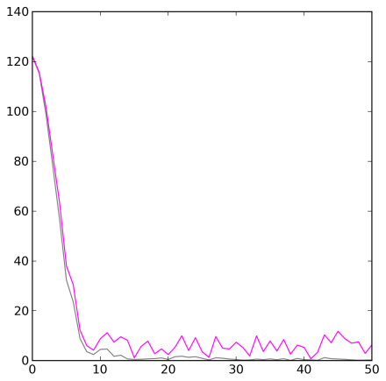
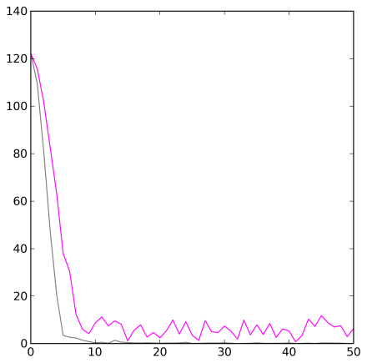
Smoothing
Intensity
w=ones(2*width+1,'d')
convolve(w/w.sum(),y,'valid‘)
Frequency
Frequency
Frequency

Slide 5
Peak Finding
The derivative of a function is zero at its
minima and maxima.
The second derivative is negative at maxima and
positive at minima.

Slide 6
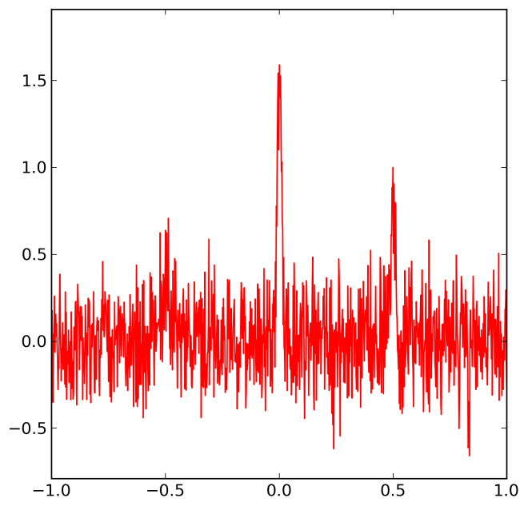
Peak Finding
Intensity
Characterize the signal and the noise
Make a model of the data
Select detection method
Select parameters using simulations

Slide 7
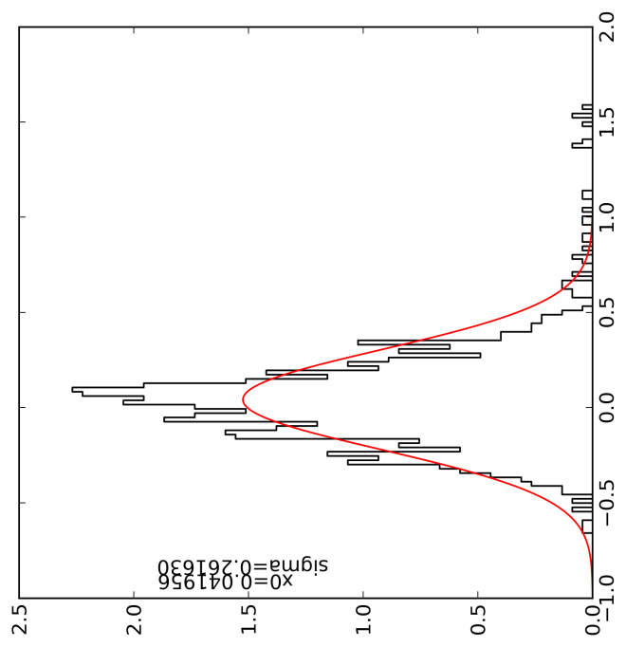
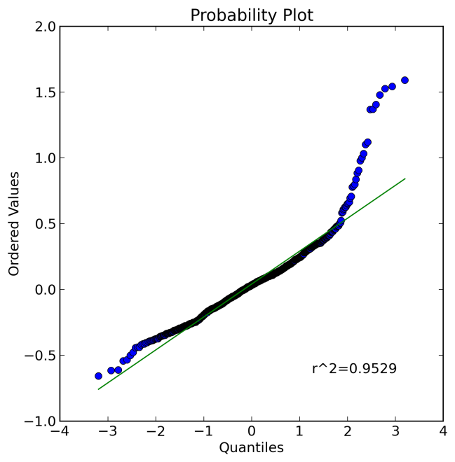
Peak Finding: Characterizing the noise
Intensity
Let’s first try without removing the peaks

Slide 8
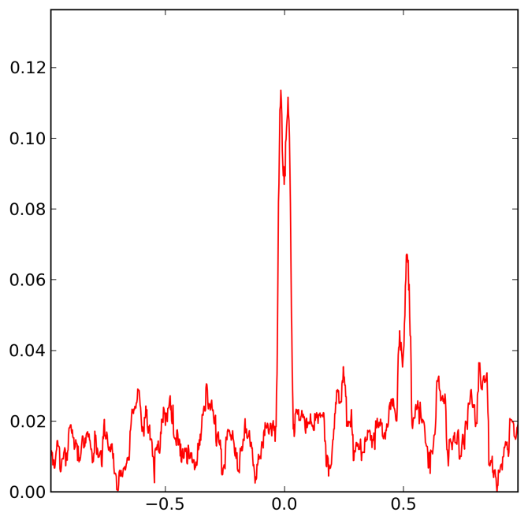
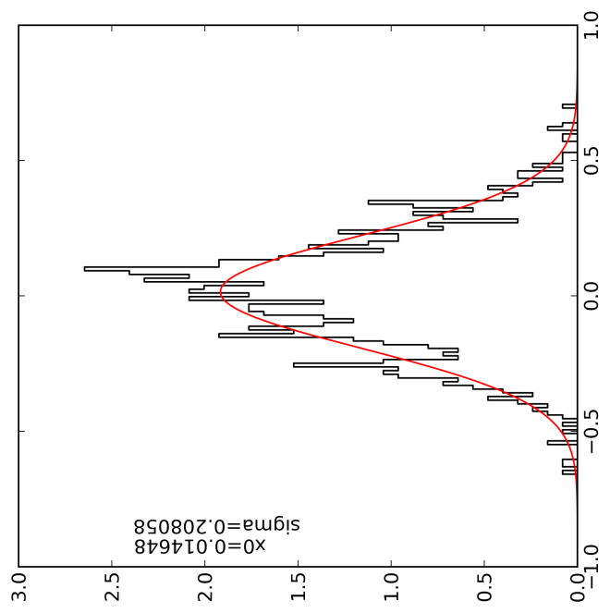
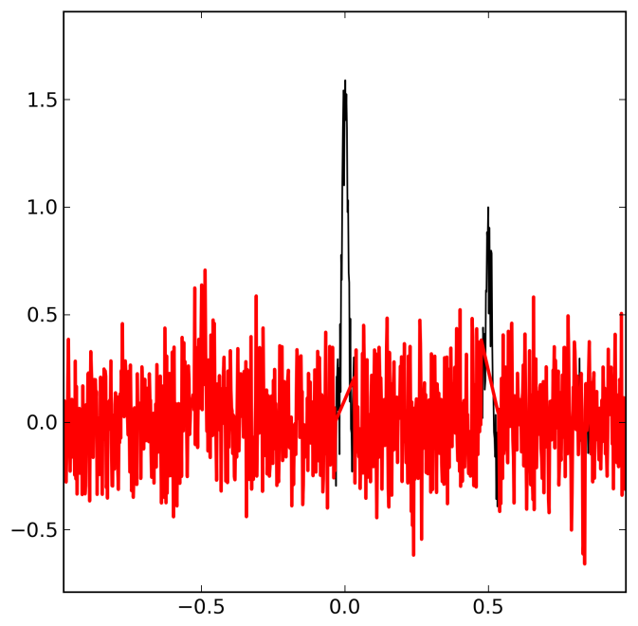
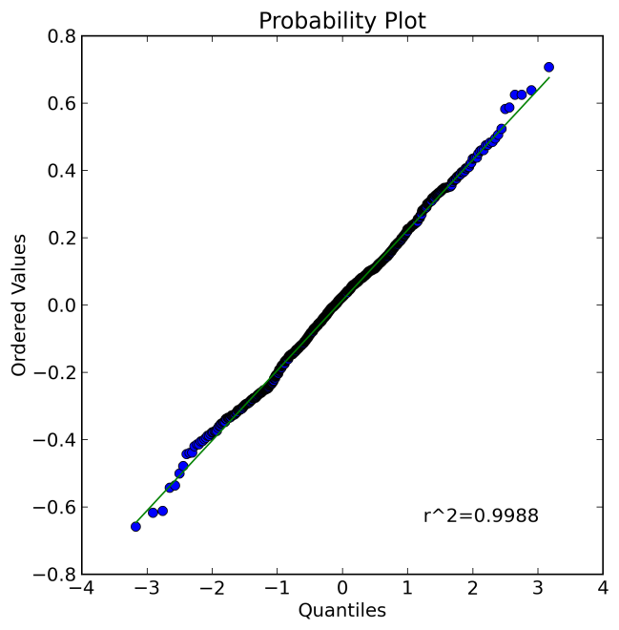
Peak Finding: Characterizing the noise
Removing the peaks
by looking for outliers
in the root mean
square deviation
(RMSD)
Intensity
RMSD

Slide 9
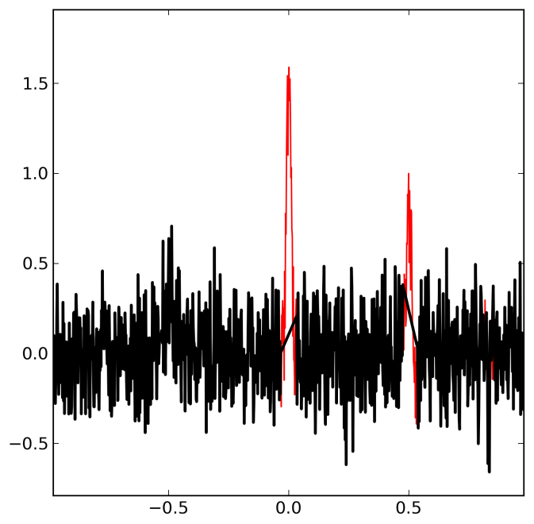
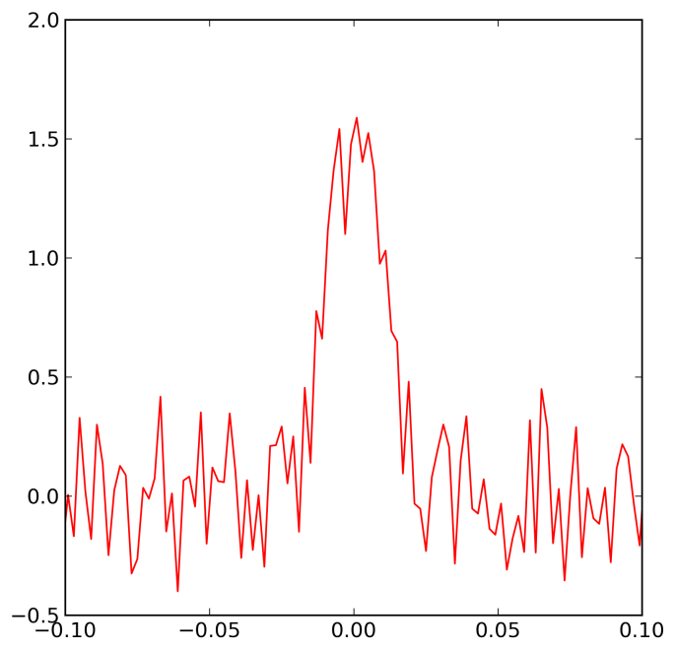
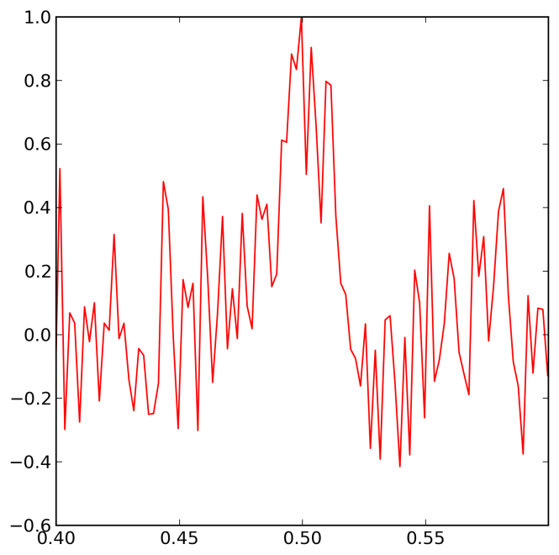
Peak Finding: Characterizing the peaks
Intensity

Slide 10
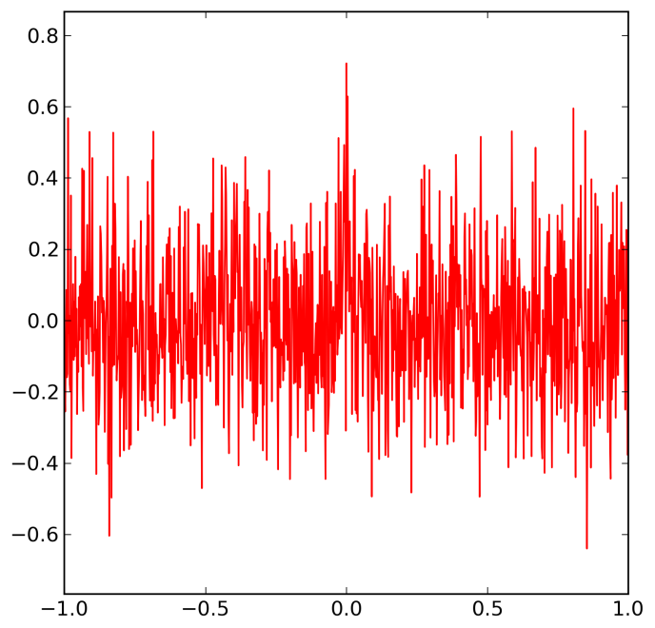
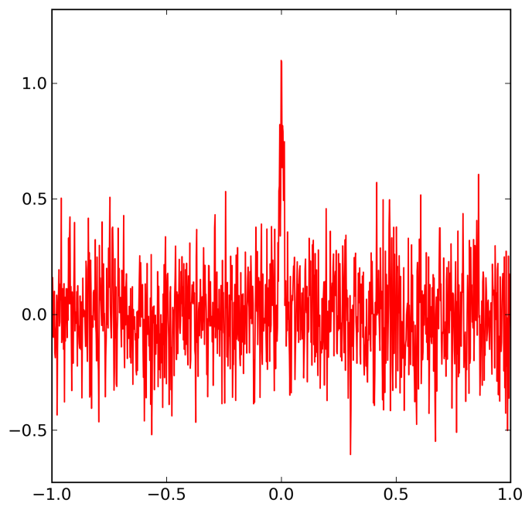
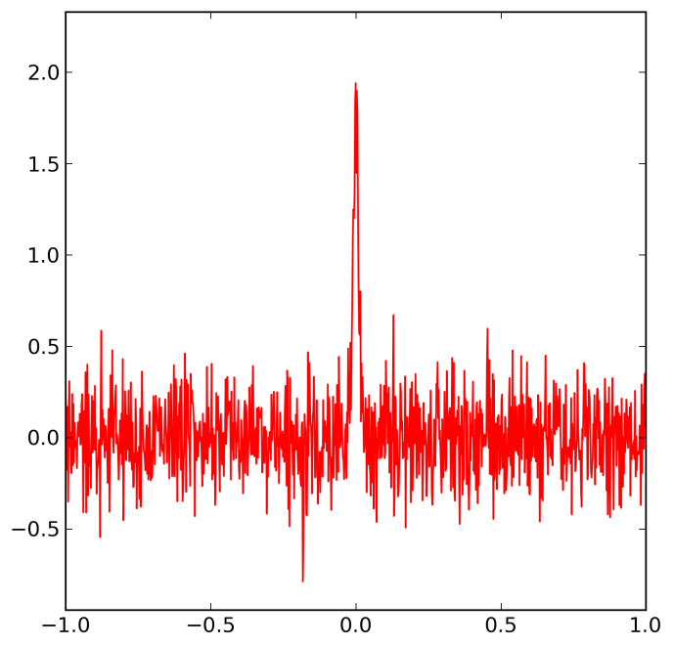
Peak Finding: Model of data
S/N=1
S/N=2
S/N=4
points=1000
x = linspace(-1,1,points)
y=noise*random.normal(size=len(x))
y+=signal*gaussian(x,0,0.01)

Slide 11
Peak Finding: Detection method
S/N=1
S/N=2
S/N=4
Peaks can be detected by finding maxima in the moving average with a window size similar to the peak width

Slide 12
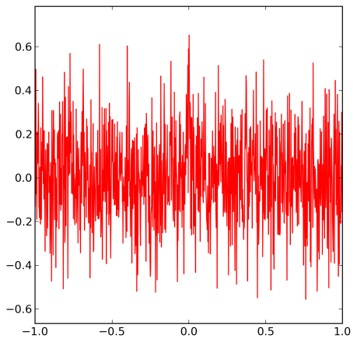
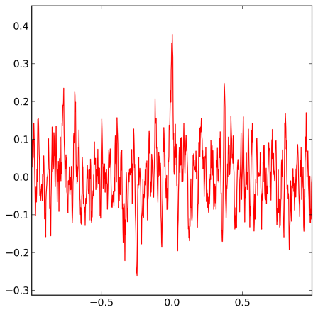
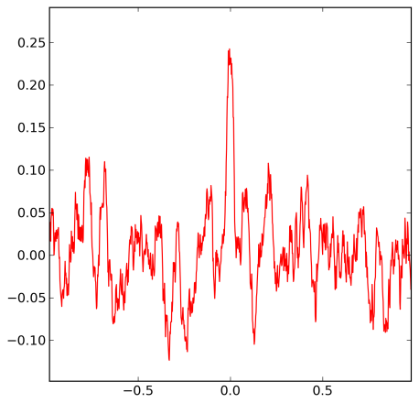
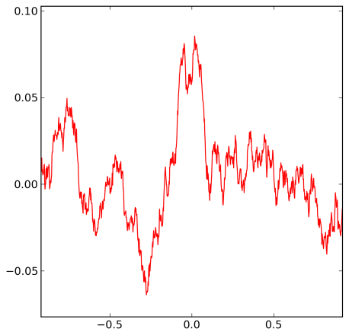
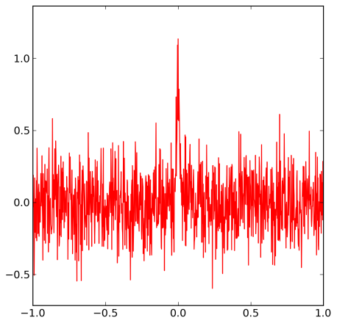
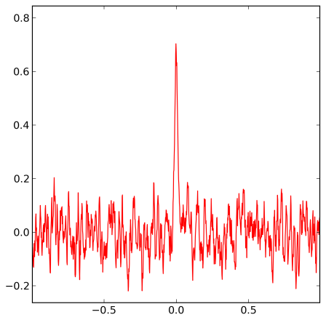
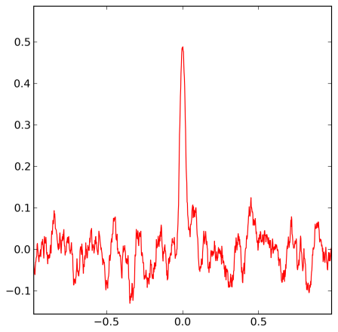
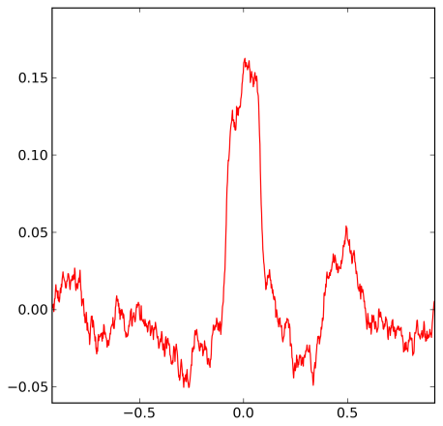
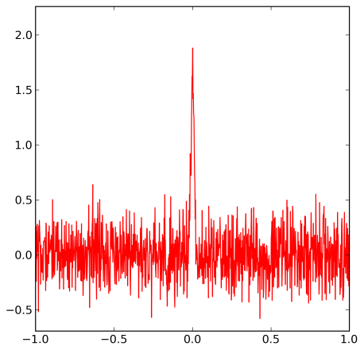
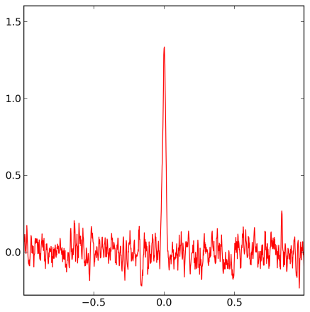
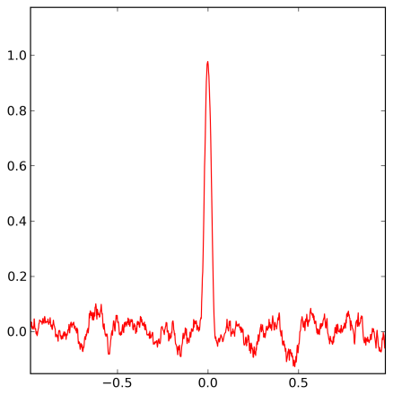
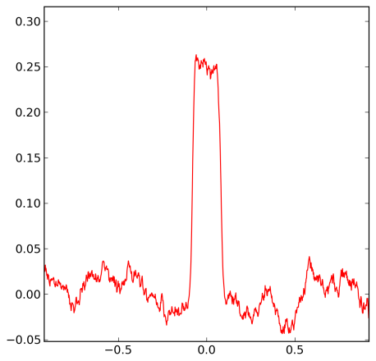
Peak Finding: Detection method – moving average
Signal
Bin size = 5
Bin size = 20
Bin size = 80
S/N=1
S/N=2
S/N=4

Slide 13
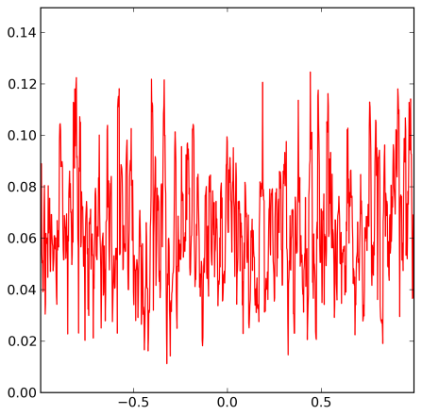
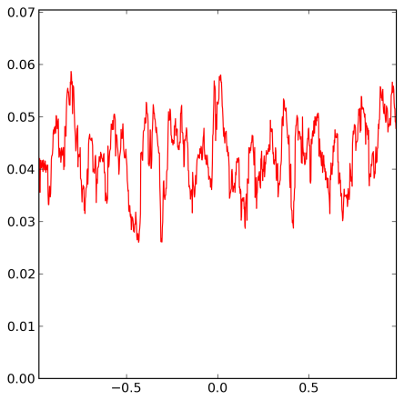
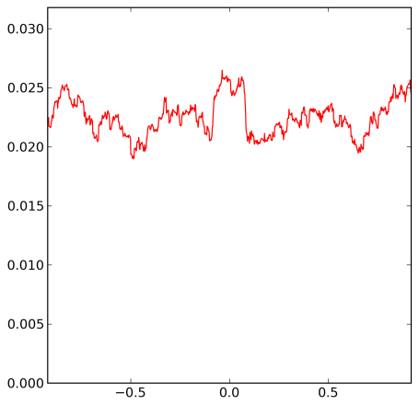
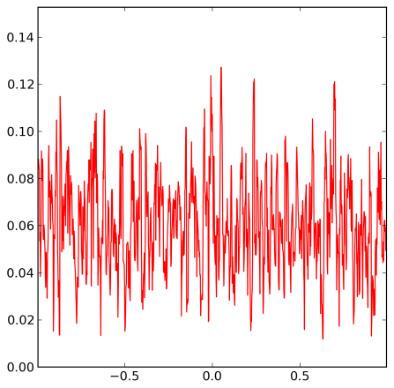
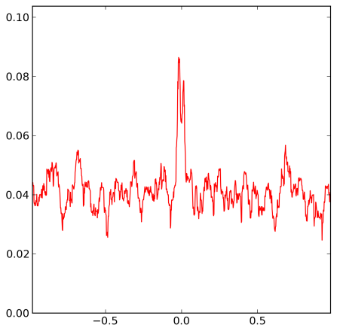
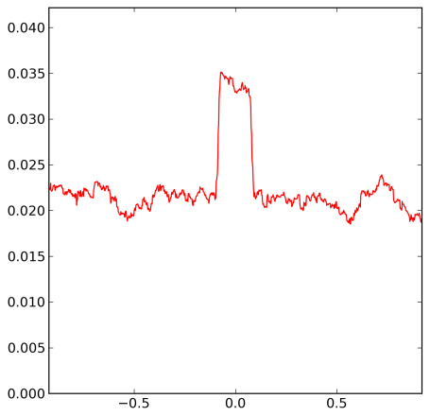
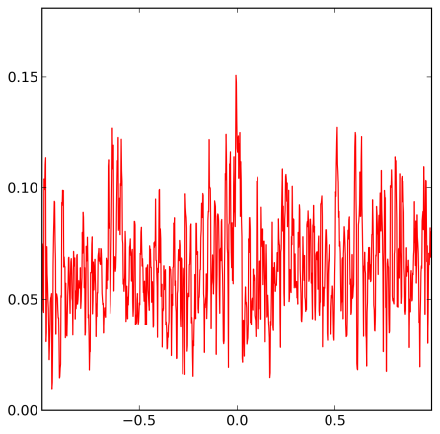
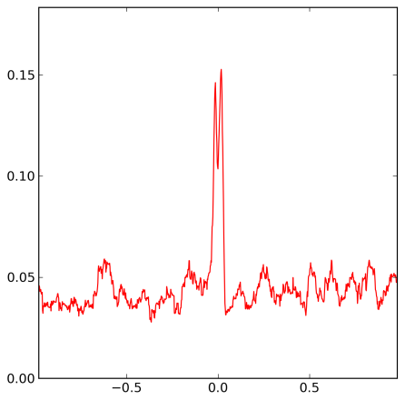

Peak Finding: Detection method – RMSD
Signal
Bin size = 5
Bin size = 20
Bin size = 80
S/N=1
S/N=2
S/N=4

Slide 14
Peak Finding: Information about the Peak
maximum
mean
variance
skewness
kurtosis
Intensity
full width
at half
maximum
(FWHM)
height
centroid
(mean)
area

Slide 15
Information about a Peak
A peak is defined by
Centroid or mean
To calculate any of these measures we need
to know where the peak starts and ends.

Slide 16


Where does a peak start and end?

Slide 17
Estimating quantity
Peak height
Peak height
Curve fitting
Curve fitting
Intensity
Peak area
m/z

Slide 18
What is the best way to estimate quantity?
Peak height - resistant to interference
- poor statistics
Peak area - better statistics
- more sensitive to interference
Curve fitting - better statistics
- needs to know the peak shape
- slow

Slide 19
Sampling
Intensity
Retention Time

Slide 20
Sampling

Slide 21
Summary
Fourier transform - transformation to frequency space and back
Signal – how do we detect and characterize signals?
Noise – how do we characterize noise?
Modeling signal and noise
Simulation to select thresholds and select parameters
Filters – fitering by low-pass (i.e. smoothing) and high-pass filters (e.g. adaptive background correction)
Detection methods based on moving average and RMSD
Convolution - describes the response of a linear and
time-invariant system to an input signal
Cross-correlation is a measure of similarity of two signals
Autocorrelation can be used for finding periodic signals obscured by noise
The dot product can be used to determine how similar two signals are
Coincidence measurements enhance the signal and supresses noise
The quantity associated with a peak – height and area
Sampling – how often do we need to sample a peak to get a good estimate of its area?

Slide 22
Image Analysis
  Inspecting slices of an image
  Thresholding
  Finding and characterizing objects
  Classifying structures
  Testing if observations are random

Slide 23

Image Manipulation in Python
r o w s
c
o
l
u
m
n
s
Image = 2D numerical array
Useful Packages:
numpy - array manipulation using ndarray
scipy.ndimage – basic image processing and analysis tools
scikit-image - more image processing & analysis tools
mahotas – more tools
matplotlib - view images with plt.imshow and fig.savefig
In order to load and save images a backend is required, e.g. PIL, freeimage, etc.

Slide 24

Gel Image Analysis Example
CDI Laboratories

Slide 25



Step 1: Separate gel images
To find the beginning of each gel, search for the marker lane by using properties of the lane that would differ from the other lanes in the image.
Step 1a: Scan image and identify red color peaks
Step 1b: At each peak found, cut out the potential “marker” lane and get its properties.

Slide 26






Step 1: Separate gel images
Criteria to detect marker lane:
Number of strong red bands
Band intensity variance
Low green signal
Relative band locations
Notes:
NOTE ! – I removed the arrows pointing to missing marker lanes and the grouping signs.

Slide 27



Step 2: Detect and Straighten Lanes
(x,0)
(x+i,y-max)

Slide 28


Step 3: Calibrate and Annotate
Red Signal
Green Signal

Slide 29

Step 4: Measure Intensity of Bands

Slide 30



Quantitation Example
Signal
Noise
Paolo Mita and Jef Boeke

Slide 31








Quantitation Example
6.7 μg
13.4 μg
33.5 μg
67.0 μg
The goal
Experiment
Measured Amount [ug]
Actual Amount [ug]
Control

Slide 32









Average Pixel Intensity
6.7 μg
13.4 μg
33.5 μg
67.0 μg
Experiment
Control
The goal
Average Pixel Intensity
Measured Concentration
Average Intensity
Actual Amount [ug]
Amount [ug]

Slide 33

Intensity Distribution
Experiment
67.0 μg
Control
Number of Pixels
Experiment
Control
Pixel Intensity

Slide 34




Intensity Distribution
6.7 μg
13.4 μg
33.5 μg
67.0 μg
Experiment
Control
Number of Pixels
Pixel Intensity

Slide 35

Average Pixel Intensity, Min Subtracted
6.7 μg
13.4 μg
33.5 μg
67.0 μg
Experiment
Control
Original image
Min Intensity Subtracted
Average Intensity
Average Intensity
Amount [ug]
Amount [ug]

Slide 36

A Slice
Pixel Intensity
Location

Slide 37








A Slice
Pixel Intensity
Location
Pixel Intensity
Location

Slide 38


A Smoothed Slice
Pixel Intensity
Location
Pixel Intensity
Location

Slide 39








A Smoothed Slice
Pixel Intensity
Location
Pixel Intensity
Location

Slide 40








A Background Subtracted Slice
Pixel Intensity
Location
Pixel Intensity
Location

Slide 41


Average Pixel Intensity, Background Subtracted
6.7 μg
13.4 μg
33.5 μg
67.0 μg
Experiment
Control
Background Subtracted
and thresholded
Background Subtracted
Average Intensity
Average Intensity
Amount [ug]
Amount [ug]

Slide 42




Quantitation Example: 0 & 1D analysis - Summary
The goal
Measured Amount [ug]
Actual Amount [ug]
Subtraction of
Minimum Intensity
Subtraction of
1D Background
Average Intensity
Average Intensity
Average Intensity
Amount [ug]
Amount [ug]
Amount [ug]

Slide 43
Quantitation Example
Signal
Noise
Paolo Mita and Jef Boeke

Slide 44

Thresholding
Histogram based thresholding methods assume the greyscale levels of the image are divided into two groups – background and foreground. They attempt to find the threshold level that best divides these two groups.
For example, Otsu’s method finds the threshold level that minimizes the variance among the classes.
scikit-image.org

Slide 45

Constant Threshold
Original
Image
Constant
Threshold

Slide 46

Adaptive Threshold
Original
Image
Adaptive
Threshold

Slide 47

Erosion
Adaptive
Threshold
Erosion

Slide 48

Removing Small Objects
Erosion
Small
objects
removed

Slide 49

Fill Objects
Small
objects
removed
Objects
Filled

Slide 50

Watershed Segmentation
Objects
Filled
Watershed
Segmentation

Slide 51





Watershed Segmentation
1. Calculate distance from each pixel to the edge and label the local maxima
from mahotas import distance, label
from skimage import feature
distances = distance(mask)
maxima = feature.peak_local_max(distances)
spots, n = label(maxima)
Bright Areas = high, dark areas = low
Change the image into another image whose catchment basins are the objects to identify.
2. Reverse the pixels and apply watershed algorithm
surface = distances.max() - distances
areas = mahotas.cwatershed(surface, spots)

Slide 52

Watershed Segmentation
3. Result: Labeled Areas are the watershed lines

Slide 53


Super Resolution Fluorescence Microscopy
Single Molecule Localization Microscopy (PALM, dSTORM)
TIRF image
SRM
PKP2
5 μm
Image from Esperanza Agullo-Pascual
Notes:
Example Image of total internal reflection fluorescence (TIRF) , f Neonatal rat ventricular myocytes or stained for PKP2, total internal reflection fluorescence (TIRF) TIRF of an inimage created from Example Image, TIRF image created from projection of 2000 frames
dSTORM image – 20 nm resolution
Axial resolution ~ 150 nm (TIRF or HiLO)

Slide 54
Overlap Example
Dylan Reid and Eli Rothenberg

Slide 55
Splitting Colors
Red Image
Original Image
Green Image

Slide 56
Constant Threshold
Original Image
Thresholded Image
Red
Image
Green
Image

Slide 57
Labeling of Particles
Thresholded
Labeled
0 0 0 0 0 0 0 0 0 0 0 0 0 0 0 0 0 0 0 0 0 0 0 0 0 0 0 0
0 0 0 0 0 0 0 0 0 0 0 0 0 0 0 0 0 0 0 0 0 0 0 0 0 0 0 0
0 0 0 0 0 0 0 0 0 0 0 0 0 0 0 0 0 0 0 0 0 1 1 1 0 0 0 0
0 0 0 0 0 0 0 0 0 0 0 0 0 0 0 0 0 0 0 0 0 0 1 1 0 0 0 0
0 0 0 0 0 0 0 0 0 0 0 0 0 0 0 0 0 0 0 0 0 0 1 1 0 0 0 0
0 0 0 0 0 0 0 0 0 0 0 0 0 0 0 0 0 0 0 0 0 0 0 0 0 0 0 0
0 0 0 0 0 0 0 0 0 0 0 0 0 0 0 0 0 0 0 0 0 0 0 0 0 0 0 0
0 0 0 0 0 0 1 0 0 0 0 0 0 0 0 0 0 0 0 0 0 0 0 0 0 0 0 0
0 0 0 0 0 1 1 1 0 0 0 0 0 0 0 0 0 0 0 0 0 0 0 0 0 0 0 0
0 0 0 0 0 1 1 1 1 0 0 0 0 0 0 0 0 0 0 0 0 0 0 0 0 0 0 0
0 0 0 0 1 1 1 1 1 0 0 0 0 0 0 0 0 0 0 0 0 0 0 0 0 0 0 0
0 0 0 0 0 1 1 1 1 0 0 0 0 0 0 0 0 0 0 0 0 0 0 0 0 0 0 0
0 0 0 0 0 1 1 1 0 0 0 0 0 0 0 0 0 0 0 0 0 0 0 0 0 0 0 0
0 0 0 0 0 0 0 0 0 0 0 0 0 0 0 0 0 0 0 0 0 0 0 0 0 0 0 0
0 0 0 0 0 0 0 0 0 0 0 0 0 0 0 0 0 0 0 0 0 0 0 0 0 0 0 0
0 0 0 0 0 0 0 0 0 0 0 0 0 0 0 0 0 0 0 0 0 0 0 0 0 0 0 0
0 0 0 0 0 0 0 0 0 0 0 0 0 0 0 0 0 0 0 0 0 0 0 0 0 0 0 0
0 0 0 0 0 0 0 0 0 0 0 0 0 0 0 0 0 0 0 0 0 0 0 0 0 0 0 0
0 0 0 0 0 0 0 0 0 0 0 0 0 0 0 0 0 0 0 0 0 0 0 0 0 0 0 0
0 0 0 0 0 0 0 0 0 0 0 0 0 0 0 0 0 0 0 0 0 1 1 0 0 0 0 0
0 0 0 0 0 0 0 0 0 0 0 0 0 0 0 0 0 0 0 0 0 1 1 1 0 0 0 0
0 0 0 0 0 0 0 0 0 0 0 0 0 0 0 0 0 0 0 0 0 1 1 0 0 0 0 0
0 0 0 0 0 0 0 0 0 0 0 0 0 0 0 0 0 0 0 0 0 0 0 0 0 0 0 0
0 0 0 0 0 0 0 0 0 0 0 0 0 0 0 0 0 0 0 0 0 0 0 0 0 0 0 0
0 0 0 0 0 0 0 0 0 0 0 0 0 0 0 0 0 0 0 0 0 0 0 0 0 0 0 0
0 0 0 0 0 0 0 0 1 1 1 0 0 0 0 0 0 0 0 0 0 0 0 0 0 0 0 0
0 0 0 0 0 0 0 1 1 1 1 0 0 0 0 0 0 0 0 0 0 0 0 0 0 0 0 0
0 0 0 0 0 0 0 1 1 1 1 1 0 0 0 0 0 0 0 0 0 0 0 0 0 0 0 0
0 0 0 0 0 0 1 1 1 1 1 0 0 0 0 0 0 0 0 0 0 0 0 0 0 0 0 0
0 0 0 0 0 0 0 1 1 1 1 0 0 0 0 0 0 0 0 0 0 0 0 0 0 0 0 0
0 0 0 0 0 0 0 0 1 1 1 0 0 0 0 0 0 0 0 0 0 0 0 0 0 0 0 0
0 0 0 0 0 0 0 0 0 0 0 0 0 0 0 0 0 0 0 0 0 0 0 0 0 0 0 0
0 0 0 0 0 0 0 0 0 0 0 0 0 0 0 0 0 0 0 0 0 0 0 0 0 0 0 0
0 0 0 0 0 0 0 0 0 0 0 0 0 0 0 0 0 0 0 0 0 0 0 0 0 0 0 0
0 0 0 0 0 0 0 0 0 0 0 0 0 0 0 0 0 0 0 0 0 0 0 0 0 0 0 0
0 0 0 0 0 0 0 0 0 0 0 0 0 0 0 0 0 0 0 0 0 0 0 0 0 0 0 0
0 0 0 0 0 0 0 0 0 0 0 0 0 0 0 0 0 0 0 0 0 0 0 0 0 0 0 0
0 0 0 0 0 0 0 0 0 0 0 0 0 0 0 0 0 0 0 0 0 1 1 1 0 0 0 0
0 0 0 0 0 0 0 0 0 0 0 0 0 0 0 0 0 0 0 0 0 0 1 1 0 0 0 0
0 0 0 0 0 0 0 0 0 0 0 0 0 0 0 0 0 0 0 0 0 0 1 1 0 0 0 0
0 0 0 0 0 0 0 0 0 0 0 0 0 0 0 0 0 0 0 0 0 0 0 0 0 0 0 0
0 0 0 0 0 0 0 0 0 0 0 0 0 0 0 0 0 0 0 0 0 0 0 0 0 0 0 0
0 0 0 0 0 0 2 0 0 0 0 0 0 0 0 0 0 0 0 0 0 0 0 0 0 0 0 0
0 0 0 0 0 2 2 2 0 0 0 0 0 0 0 0 0 0 0 0 0 0 0 0 0 0 0 0
0 0 0 0 0 2 2 2 2 0 0 0 0 0 0 0 0 0 0 0 0 0 0 0 0 0 0 0
0 0 0 0 2 2 2 2 2 0 0 0 0 0 0 0 0 0 0 0 0 0 0 0 0 0 0 0
0 0 0 0 0 2 2 2 2 0 0 0 0 0 0 0 0 0 0 0 0 0 0 0 0 0 0 0
0 0 0 0 0 2 2 2 0 0 0 0 0 0 0 0 0 0 0 0 0 0 0 0 0 0 0 0
0 0 0 0 0 0 0 0 0 0 0 0 0 0 0 0 0 0 0 0 0 0 0 0 0 0 0 0
0 0 0 0 0 0 0 0 0 0 0 0 0 0 0 0 0 0 0 0 0 0 0 0 0 0 0 0
0 0 0 0 0 0 0 0 0 0 0 0 0 0 0 0 0 0 0 0 0 0 0 0 0 0 0 0
0 0 0 0 0 0 0 0 0 0 0 0 0 0 0 0 0 0 0 0 0 0 0 0 0 0 0 0
0 0 0 0 0 0 0 0 0 0 0 0 0 0 0 0 0 0 0 0 0 0 0 0 0 0 0 0
0 0 0 0 0 0 0 0 0 0 0 0 0 0 0 0 0 0 0 0 0 0 0 0 0 0 0 0
0 0 0 0 0 0 0 0 0 0 0 0 0 0 0 0 0 0 0 0 0 3 3 0 0 0 0 0
0 0 0 0 0 0 0 0 0 0 0 0 0 0 0 0 0 0 0 0 0 3 3 3 0 0 0 0
0 0 0 0 0 0 0 0 0 0 0 0 0 0 0 0 0 0 0 0 0 3 3 0 0 0 0 0
0 0 0 0 0 0 0 0 0 0 0 0 0 0 0 0 0 0 0 0 0 0 0 0 0 0 0 0
0 0 0 0 0 0 0 0 0 0 0 0 0 0 0 0 0 0 0 0 0 0 0 0 0 0 0 0
0 0 0 0 0 0 0 0 0 0 0 0 0 0 0 0 0 0 0 0 0 0 0 0 0 0 0 0
0 0 0 0 0 0 0 0 4 4 4 0 0 0 0 0 0 0 0 0 0 0 0 0 0 0 0 0
0 0 0 0 0 0 0 4 4 4 4 0 0 0 0 0 0 0 0 0 0 0 0 0 0 0 0 0
0 0 0 0 0 0 0 4 4 4 4 4 0 0 0 0 0 0 0 0 0 0 0 0 0 0 0 0
0 0 0 0 0 0 4 4 4 4 4 0 0 0 0 0 0 0 0 0 0 0 0 0 0 0 0 0
0 0 0 0 0 0 0 4 4 4 4 0 0 0 0 0 0 0 0 0 0 0 0 0 0 0 0 0
0 0 0 0 0 0 0 0 4 4 4 0 0 0 0 0 0 0 0 0 0 0 0 0 0 0 0 0
0 0 0 0 0 0 0 0 0 0 0 0 0 0 0 0 0 0 0 0 0 0 0 0 0 0 0 0
0 0 0 0 0 0 0 0 0 0 0 0 0 0 0 0 0 0 0 0 0 0 0 0 0 0 0 0
0 0 0 0 0 0 0 0 0 0 0 0 0 0 0 0 0 0 0 0 0 0 0 0 0 0 0 0
0 0 0 0 0 0 0 0 0 0 0 0 0 0 0 0 0 0 0 0 0 0 0 0 0 0 0 0

Slide 58
Finding Objects
Original Image
Objects Found

Slide 59
Measurement of Particles
r o w s
Some useful measurements available:
Area
Centroid
Eccentricity
Circularity*
Major Axis Length
Minor Axis Length
Min/Mean/Max Intensity
Orientation
Perimeter
Coordinate List
Bounding Box
c
o
l
u
m
n
s
* calculated from Area & Perimeter
Notes:
Slide 38

Slide 60

Particle Associations
Overlap between particles
Parent/Child Particles
Area vs. Overlap Area
Useful for detecting structures

Slide 61

Overlap area in images with two different cluster densities
Overlap Area = 600,800 nm²
Percentage Overlap = 38%
Overlap Area = 1,000,400 nm²
Percentage Overlap = 53%

Slide 62

1. Read Image and ROI Mask
2. Generate Simulations with different Interaction Factors, from stochastic placement of clusters (Interaction Factor = 0) to increased probability of Overlap (Interaction Factor = 1)
3. Calculate percentage of overlap for experimental image and simulations
4. Model Fitting
5. Prediction of Interaction Factor (IF) for experimental image
IF = 0.90
Notes:
Change letter size

Slide 63







Experimental
Simulation IF = 0
Simulation IF = 0.90
Notes:
Example of Super resolution image, and explain what kind of questions we can answer like protein-protein interaction but studying co-localization.
However you cannot tell whether they are random or not. Give two examples of two highly dense images both are random but one has more overlaps because there is more red. and give the IF s for the two same images, we have created a new measure obtained by modeling cluster interactions.

Slide 64

Example of Simulation
Scale:2 μm
Magnification: 500 nm

Slide 65

Interaction Factor with images of different cluster densities

Slide 66

Classifying Structures

Slide 67


Classifying Structures

Slide 68

More Colors
Yangdong Yin, Dylan Reid and Eli Rothenberg

Slide 69

More Dimensions
Esperanza Agullo-Pascual, Alejandra Leo-Macias, Dylan Reid, Mario Delmar and Eli Rothenberg

Slide 70

Live Imaging
Paolo Mita and Jef Boeke

Slide 71
Image Analysis - Summary
  Inspecting slices of an image
  Thresholding
  Finding and characterizing objects
  Classifying structures
  Testing if observations are random

